Slide 1
The “Usual Suspects”.
Methods Employed by the Romanian Securitate in the Surveillance of Writers in the Late 80s
By Clara Mares

Slide 2
Securitate
The instrument of terror in Romania
Established in august 1948, “eyes and ears of the people”
The mind-set in 80’ : Securitate “is everywhere, knows everything, sees everything”

Slide 3
Romanian society, a succession of prisons
Kindergarten
School
University
Army
Institute/Enterprise
Personal houses

Slide 4
Methods used in surveillance
General informational surveillance, a database that includes former political prisoners, persons who made comments against the regime, listeners to foreign radio stations

Slide 5
Methods used in surveillance
Priority informational surveillance, an elevated form of the previous one, paying more attention to people who could create problems
Verification brief, a temporary surveillance aiming to clear up a particular aspect,

Slide 6
Methods used in surveillance
Individual surveillance file,
the most detailed form of surveillance, without any time limitation, involving phone tapping, opening letters and postal parcels, home searches, especially while the owner was absent. The person was tracked at home, at work, at parties, wherever he went.

Slide 7
Dimension of surveillance
The secret archive includes three document funds, adding up to a total of 49 volumes.
Individual surveillance files, verification briefs or other minor investigation not included.

Slide 8
Measures taken by the Securitate
“giving a positive influence”: by secret agents
“calming down” the target : by friends, family
reports at the Communist Party bodies
“isolating” : intimidating friends, colleagues
“compromising”: official, propaganda actions
the “warning”: at the Securitate headquarters

Slide 9
Number of mistreatments
in 1988 Securitate documents estimates around 2500 measures taken at national level to prevent hostile actions.

Slide 10
Once upon a time…
Ion D. Sîrbu (n. 1919, d. 1989)
arrested in 1957,
seven years of prison, three years of forcer labor
1963-1964 miner in a coal mine
1964-1973 literary secretary at a theatre
1974-1989 he wrote novels like Farewell to Europe! or The wolfe and the Cathedral, and hundreds of letters about living under a communist regime

Slide 11
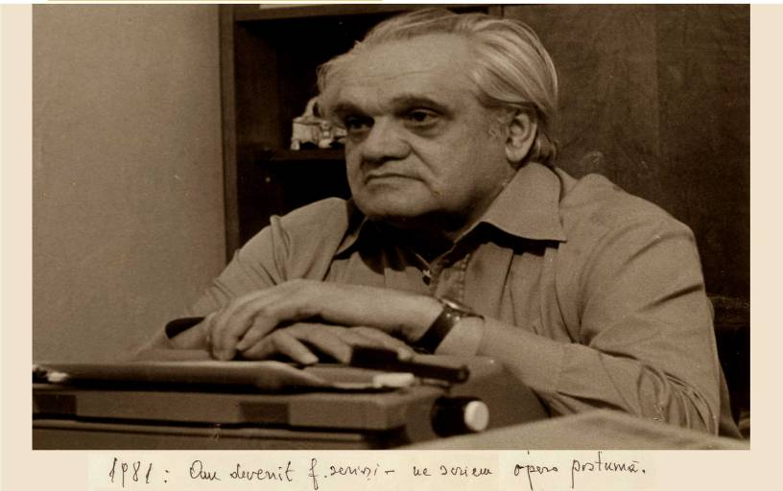
A man who traveled into the night

